Slide 1

The Abandoned Housing Effect on Newark
By: Amita Abhang, Melat Bekele,
Ernesto Cancel, Isabella Lehar, and Tim Weir

Slide 2
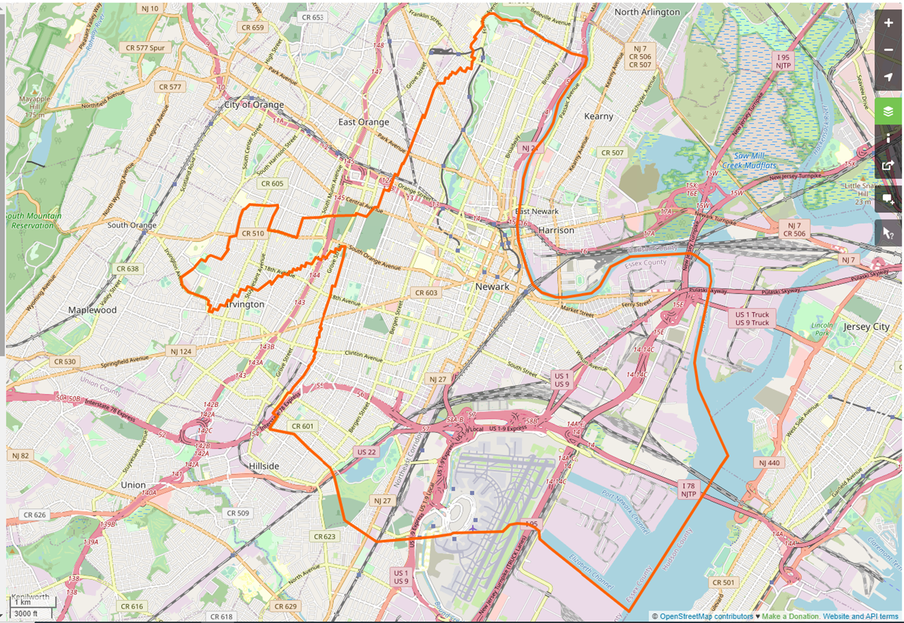
Project Info
Abstract:
The city of Newark, NJ has compiled a list of multiple abandoned and vacant buildings. From this list, our goal was to find a correlation between this list and the factors that may have contributed to the number of abandoned properties. The overall data on city statistics of housing demographics, crime, education, and poverty were obtained and evaluated.
Source: TIGER/Line® 2008 Place Shapefiles (http://www.census.gov/geo/www/tiger/)

Slide 3
General Data Mining and Cleaning Process
Study the overall housing, abandoned properties and crime rate, education rate and poverty rate in Newark , NJ.
Data compromises of 2019 and some findings use data from 2015-2019
Data was fetched in CSV for housing and API calls for further part of project
Data was rolled up to city level as some data was available by city and state
Data was cleaned to remove the unwanted characters, combining diff. files, iloc for specific rows/columns in master data file, mapping data sets, drop the NA

Slide 4
Overall Housing
Newark, NJ

Slide 5
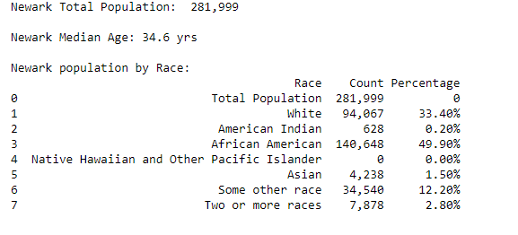
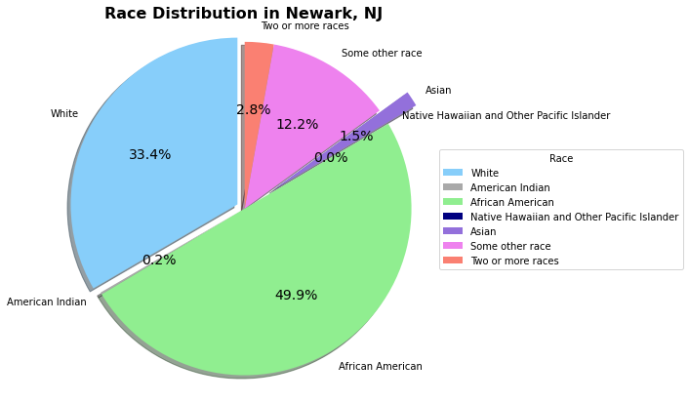
Demographics of Newark, NJ in 2019
Census website was the source of data for the capturing Housing info in Newark

Slide 6
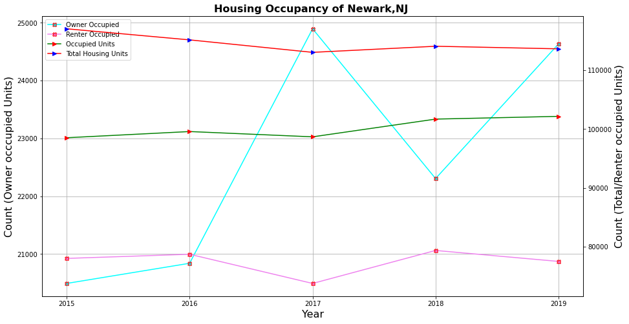
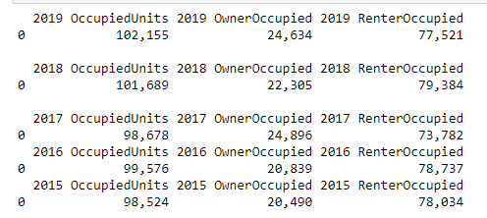
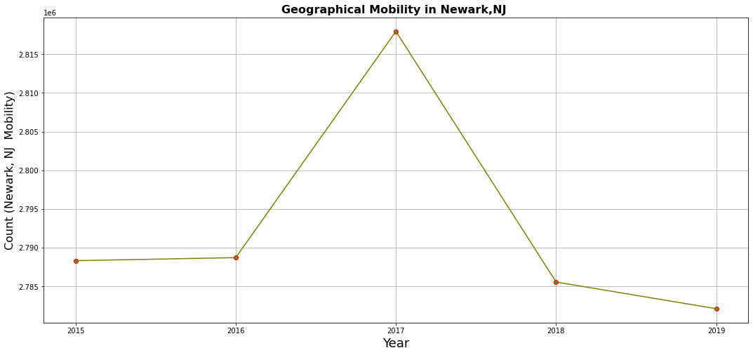
Housing Occupancy, Geographical Mobility were analyzed and plotted for data over 5years
Gradual decrease on housing units from 2015 to 2019
Highest mobility was observed in Newark in 2017, which gradually decreased by 2019

Slide 7
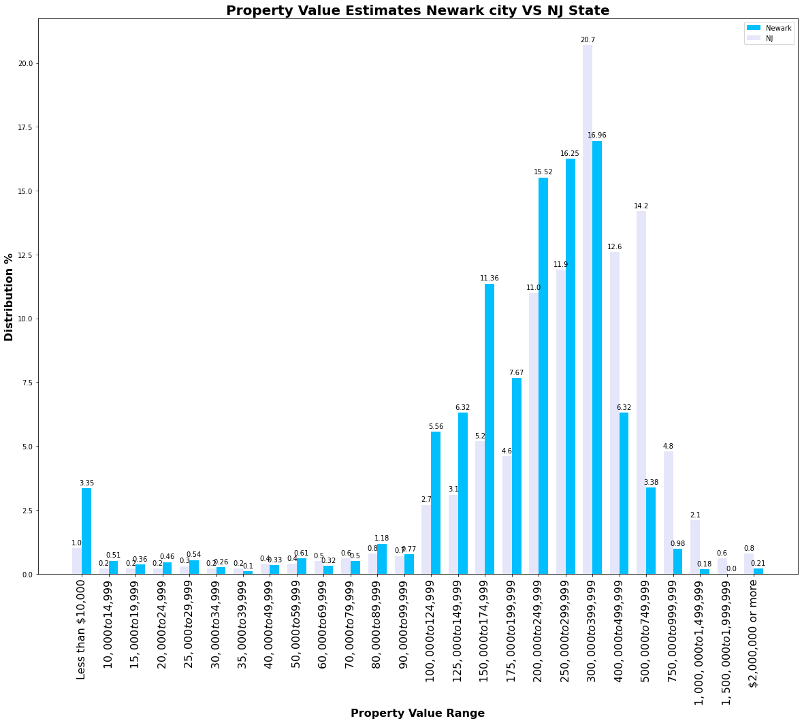
Property value distribution chart covers percentage of properties for different price ranges.
The data shows details of NJ state vs Newark properties distribution
Data captured is for 5 years from 2015-2019

Slide 8
Abandoned Housing

Slide 9
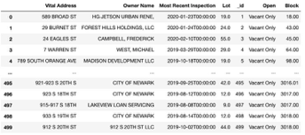
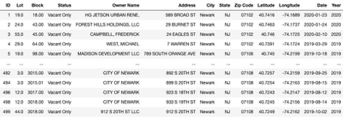
The City of Newark maintains an abandoned property list which is callable via API containing approximately 500 abandoned properties.
The data is not compatible with data from other sources, addresses are incomplete and not suitable for data analysis.
Various data cleaning techniques were employed resulting in usable data that is now compatible with additional data sets for deeper analyses.
The cleaning process resulted in minimal data loss

Slide 10
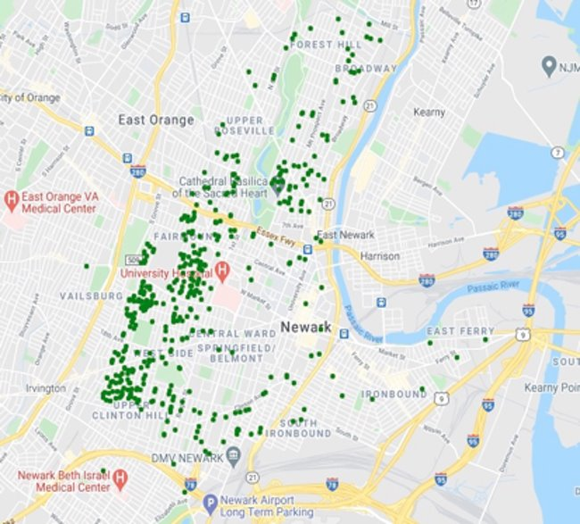
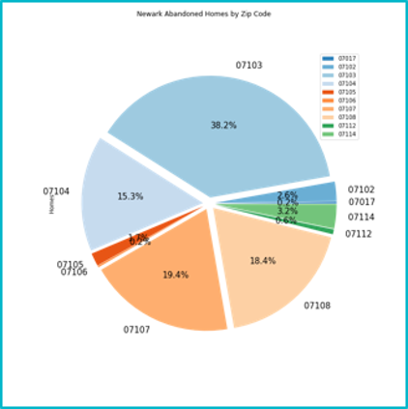

Slide 11
Poverty Rates

Slide 12
Poverty Rates in Newark, NJ by Zip Code
Data retrieved from 2019 US Census and Google Places API to show poverty rates within 10 Newark zip codes.
Geographic coordinates pulled from main abandoned property data frame.
Coordinates were averaged and then grouped by zip codes, an “alternative” to finding the geographic location of each zip code without using geocoder…
Coordinates were averaged and then grouped by zip codes, an “alternative” to finding the geographic location of each zip code without using geocoder…
Coordinates were averaged and then grouped by zip codes, an “alternative” to finding the geographic location of each zip code without using geocoder…
Here’s what the cleaned data frame looks like:
Zip Code | Latitude | Longitude | Population | Poverty Count | Poverty Rate
7017 | 40.765034 | -74.191154 | 36471 | 5858 | 16.06207672
7102 | 40.734715 | -74.173546 | 13505 | 3935 | 29.13735653
7103 | 40.738434 | -74.20323 | 32881 | 10983 | 33.40226879
7104 | 40.763977 | -74.170395 | 51075 | 12676 | 24.81840431
7105 | 40.728134 | -74.15335 | 52008 | 11304 | 21.73511767
7106 | 40.74497 | -74.219864 | 33851 | 7827 | 23.12191663
7107 | 40.75418 | -74.19209 | 37684 | 10950 | 29.0574249
7108 | 40.724895 | -74.205986 | 23118 | 8457 | 36.58188425
7112 | 40.712593 | -74.19975 | 25016 | 5280 | 21.10649185
7114 | 40.72138 | -74.18342 | 12024 | 2456 | 20.42581504

Slide 13
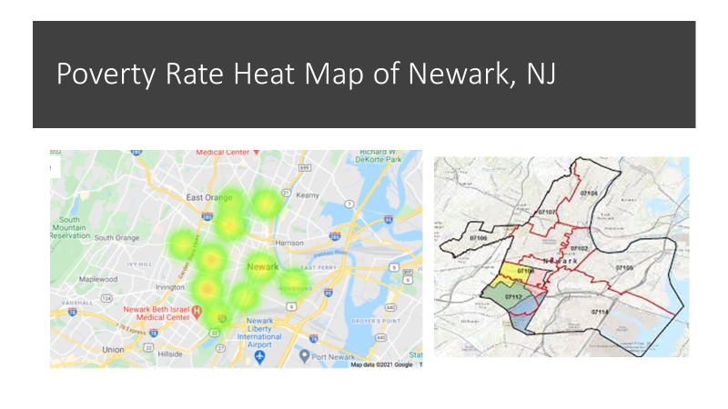

Slide 14
Education

Slide 15
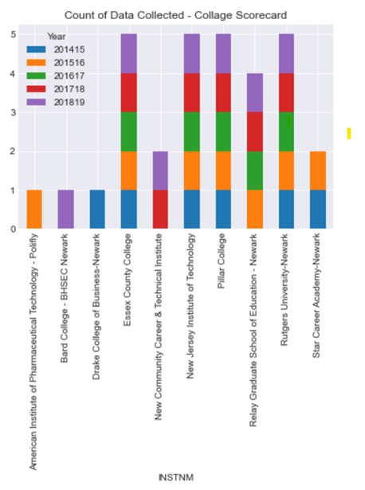
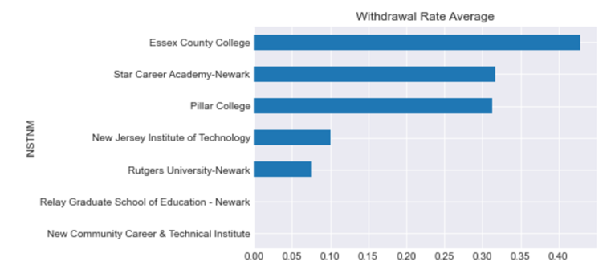
Education plays a major part in housing
Leaving in an area where there are abounded housing will reduce the tax collected for the Township which in turn is allocated for infrastructure.
When we talk about buying back the housing and reviving Newark, students do play a part. With higher education comes high Income which will allow them to buy back their area.
Comparing NJ College Data from Year 2014 to 2019

Slide 16
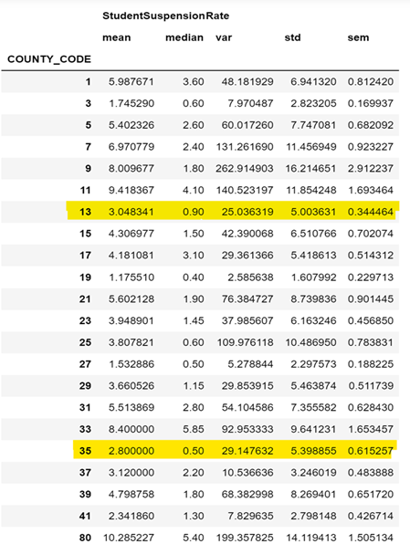
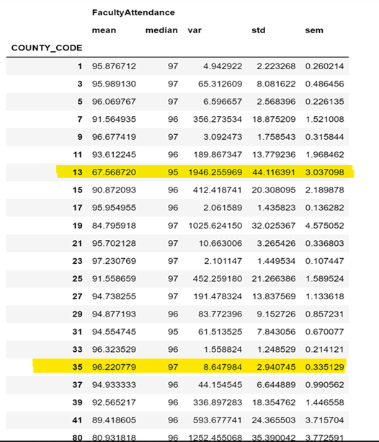
Comparing the High School for FY 2016 - 2017
County Codes:
Newark:13 Somerville: 35

Slide 17
Crime in Newark
Crimes rates Years 2018, 2019, 2020

Slide 18
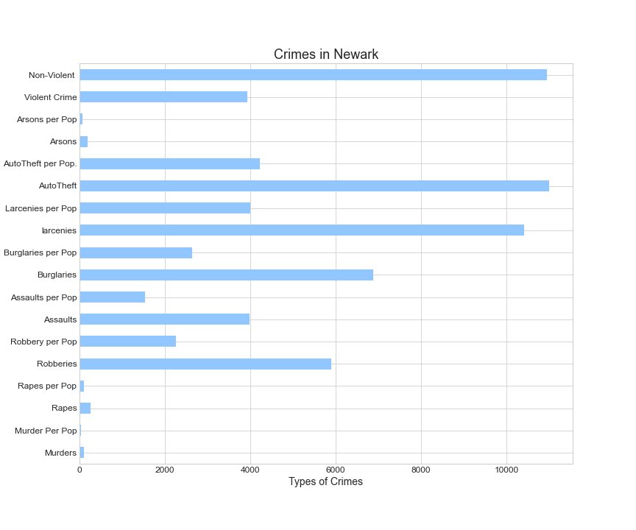
Crime within Newark
Crimes within Newark in 2018 by stand-alone totals and by totals compared to population (at the time of data collection)
Total population of 275221 at the time the study was taken.
Crimes | Totals
Murders | 96
Murder Per Pop | 36.89
Rapes | 257
Rapes per Pop | 98.76
Robberies | 5892
Robbery per Pop | 2264.13
Assaults | 3977
Assaults per Pop | 1528.25
Burglaries | 6879
Burglaries per Pop | 2643.41
larcenies | 10420
Larcenies per Pop | 4004.12
AutoTheft | 10993
AutoTheft per Pop. | 4224.31
Arsons | 184
Arsons per Pop | 70.71
Violent Crime | 3928.03
Non-Violent | 10942.54

Slide 19
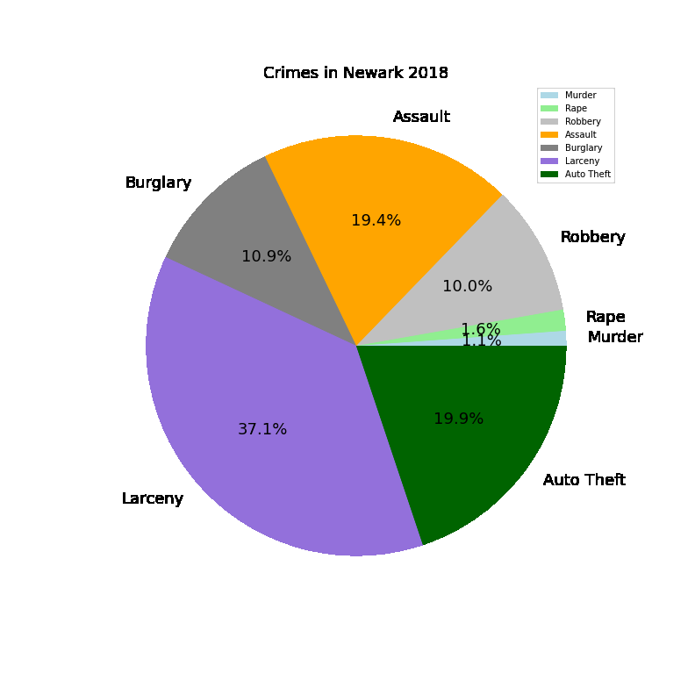
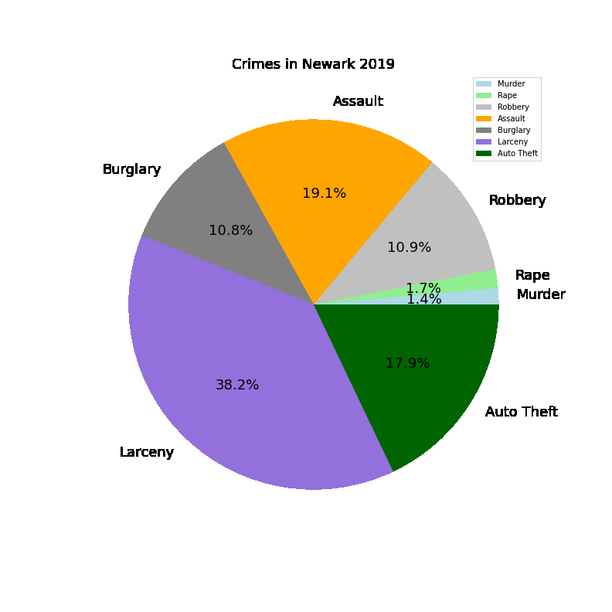
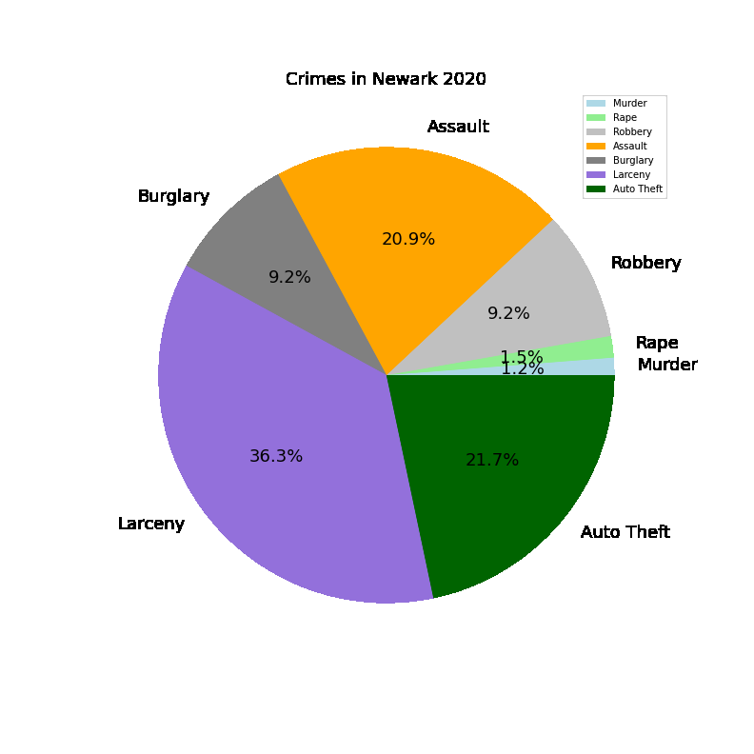
Crime Percentages 2018, 2019, 2020
 | Larceny | Burglary | Assault | Robbery | Rape | Murder | Auto Theft
2018 | 37.1% | 10.9% | 19.4% | 10.0% | 1.6% | 1.1% | 19.9%
2019 | 36.3% | 9.2% | 20.9% | 9.2% | 1.5% | 1.2% | 21.7%
2020 | 38.2% | 10.8% | 19.1% | 10.9% | 1.7% | 1.4% | 17.9%

Slide 20
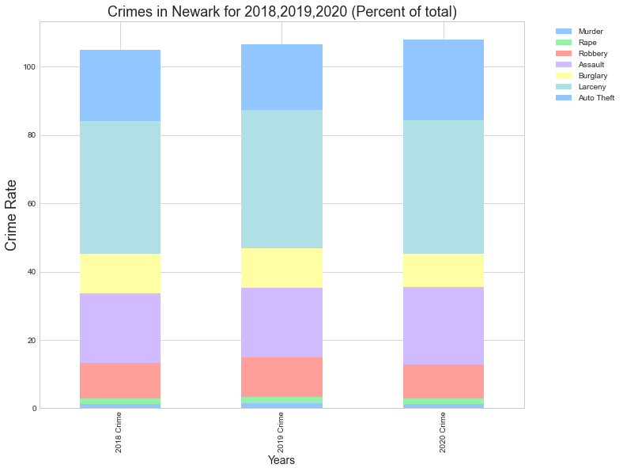
Total Crimes 2018, 2019, 2020
Crime data was pulled from the URC (United Crime Report of the State Police of NJ) for 2018,2019, 2020
Graph demonstrates the changes in crime rates over the last 3 years
The highest crime rate is Larceny
This graph quickly shows that the overall crime rate has not changed dramatically over the last 3 years.
Even though it looks like there is no real change, the over all crime dropped by 29.5% from 2019 to 2020 compared to 15.3% drop from 2018 to 2019.
In conclusion, the over all crime rate is decreasing in these three years.
Year | Murder | Rape | Robbery | Assault | Burglary | Larceny | Auto Theft | Total # of crimes
2018 | 1.20505 | 1.702244 | 10.474949 | 20.3238 | 11.445029 | 38.86654587 | 20.8151029 | 13576.2
2019 | 1.5159294 | 1.762203 | 11.576584 | 20.3554 | 11.525241 | 40.65423407 | 19.08400268 | 11491.3
2020 | 1.3255986 | 1.65021 | 9.9247099 | 22.53765 | 9.8778079 | 39.10886201 | 23.38681807 | 8102
Data Disclaimer: 2020 data is from Jan to Sept of that year so could be missing the full year calc.

Slide 21
Observed conclusions:
Gradual decrease was observed in overall housing units from 2015-2019.
07103 contains the highest percentage of abandoned properties.
Zip codes with highest poverty rates: 07108, 07103, and 07102.
Essex County College, Newark, NJ had the highest withdrawal rate from 2014-2019 for the data collected during this timeframe. High School suspension rate for 2016-2017 could have an impact on the college drop out rate for the same time frame.
Crime rate in Newark was seen to be high in 2018 and the owner- occupied housing units went down in 2018. We observed an increase in owner occupied units in 2019 and at the same time showed a decrease in crime rate.

Slide 22
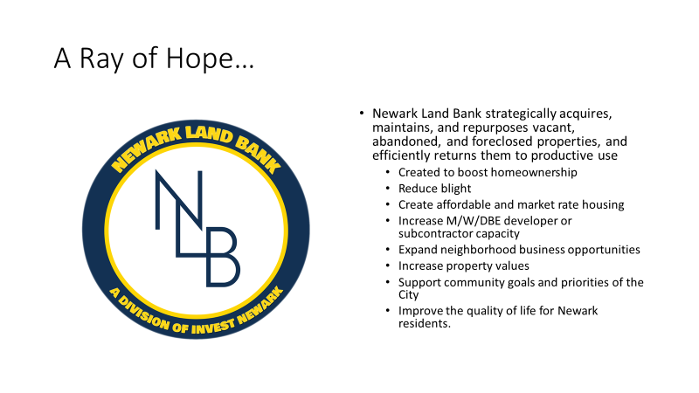

Slide 23
Citations:
Attomdata Solutions. (2018) https://api.developer.attomdata.com/docs#PropertyDataDictionary
Abandoned House Data http://data.ci.newark.nj.us/dataset/abandoned-properties/resource/796e2a01-d459-4574-9a48-23805fe0c3e0
Newark abandoned housing data source
http://data.ci.newark.nj.us/dataset/abandoned-properties/resource/796e2a01-d459-4574-9a48-23805fe0c3e0
2019 American Community Survey 5-Year https://api.census.gov/data/2019/acs/acs5?get=NAME,group(B01001)&for=us:1
Newark Land Bank. (copyright 2021). https://landbank.investnewark.org/
City of Newark Open Data. http://data.ci.newark.nj.us/dataset/abandoned-properties
New Jersey State Police, (copyright 2007-2021),Uniform Crime Reports, https://www.njsp.org/ucr/uniform-crime-reports.shtml
Communities and Crime Unnormalized Data Set. http://archive.ics.uci.edu/ml/machine-learning-databases/00211/
Administrator portal https://nj.gov/education/administrators/
US Dept of Education: College Scorecard, https://www.kaggle.com/kaggle/college-scorecard

